Slide 1
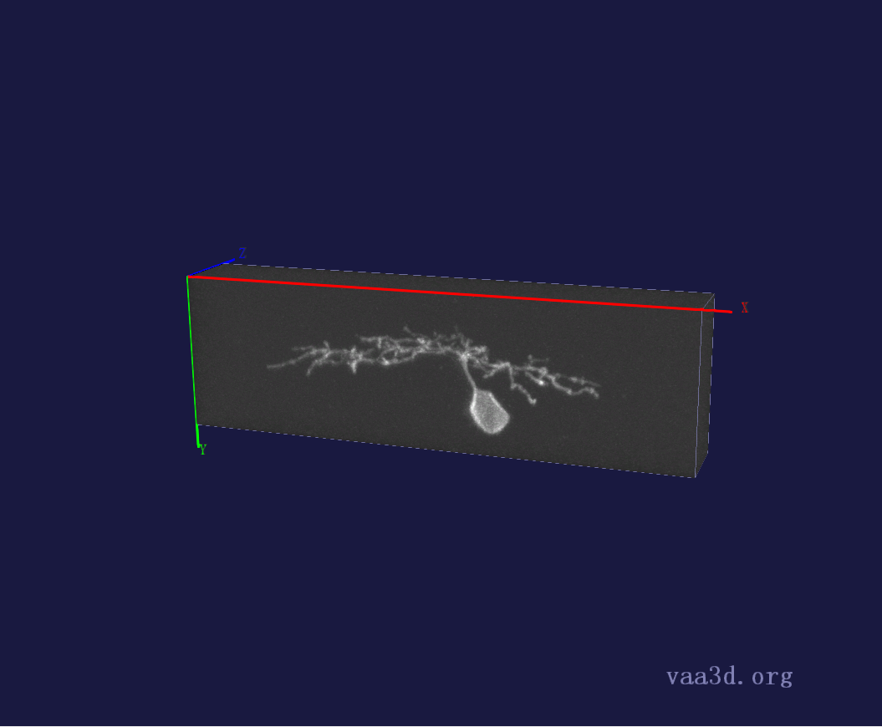
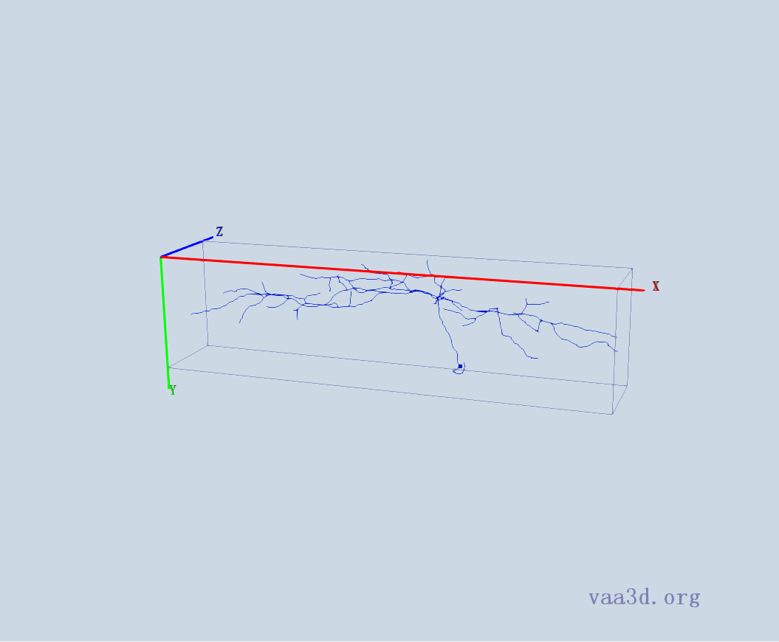
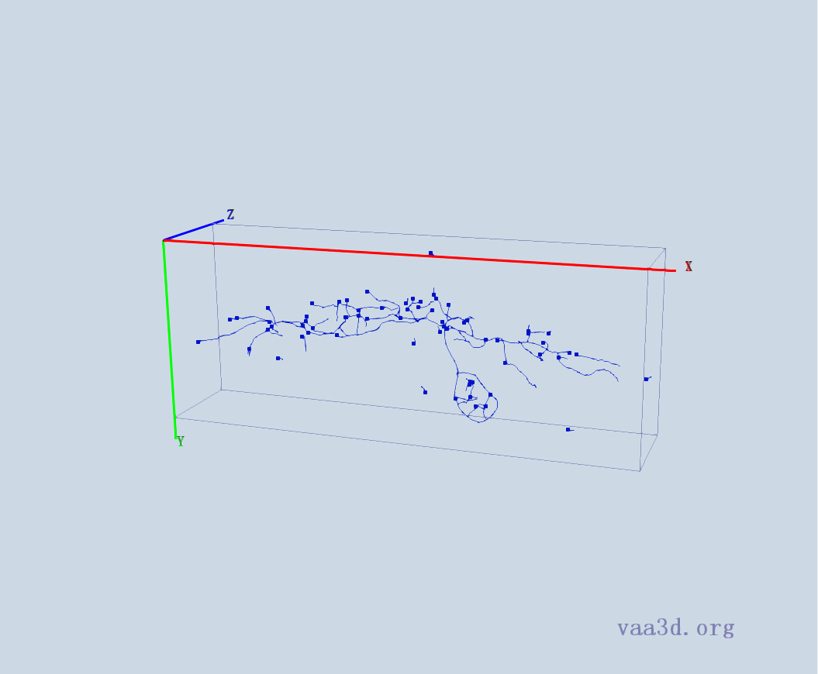
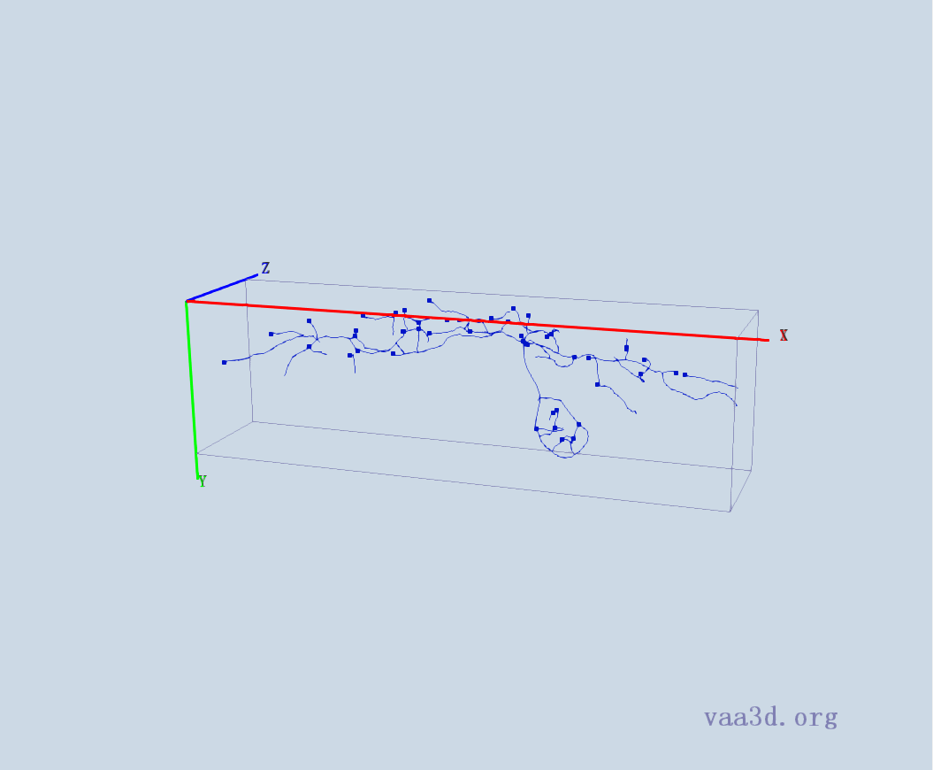
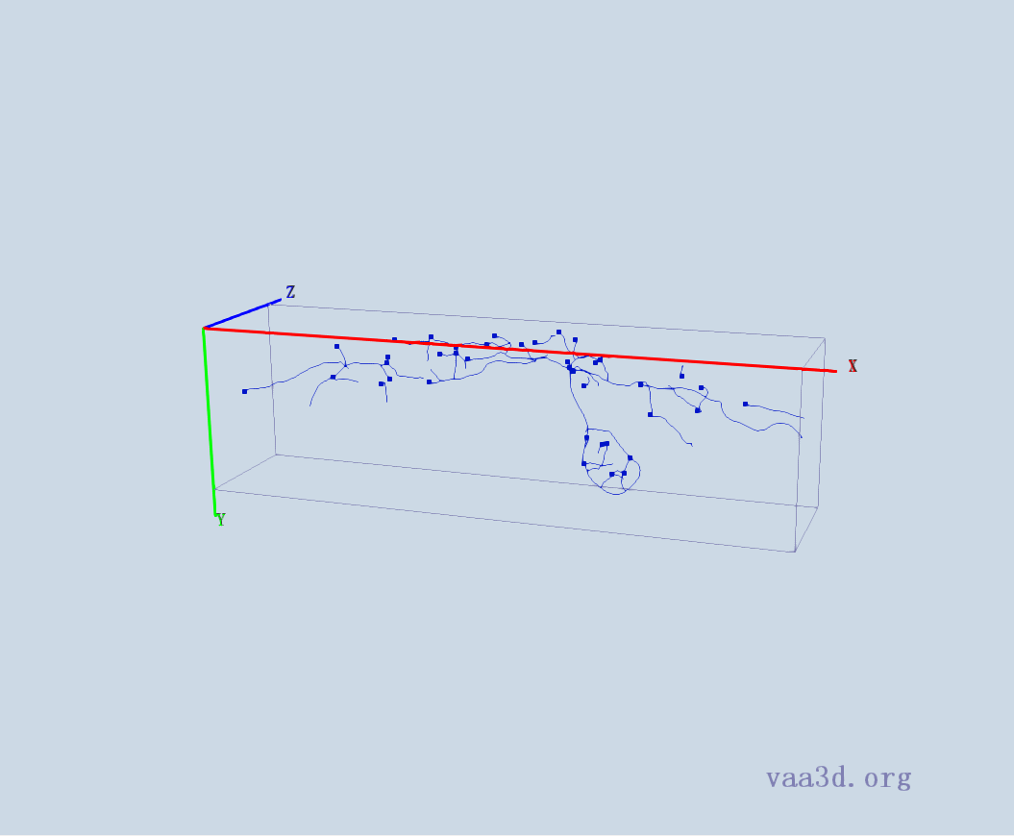

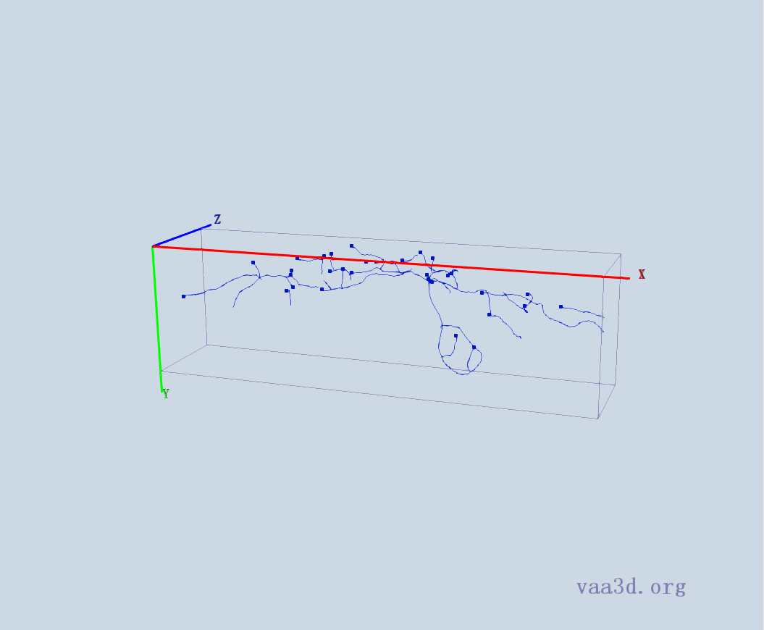
1_5dpf_Live_1-30-2010_12-39-26_PM_med_Red
GT
Thre=5 Thre= 8 Thre= 10
Thre=13 Thre= 15

Slide 2
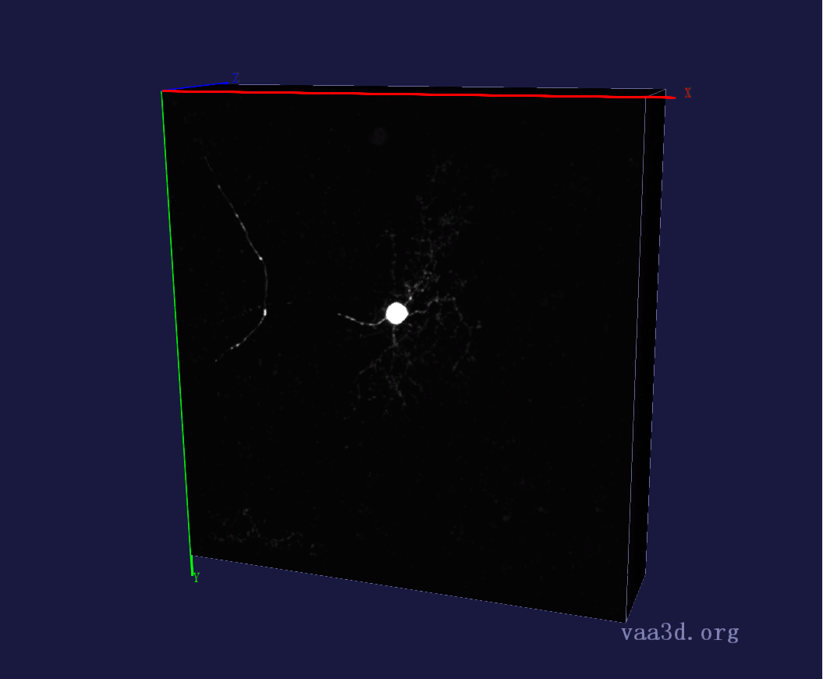
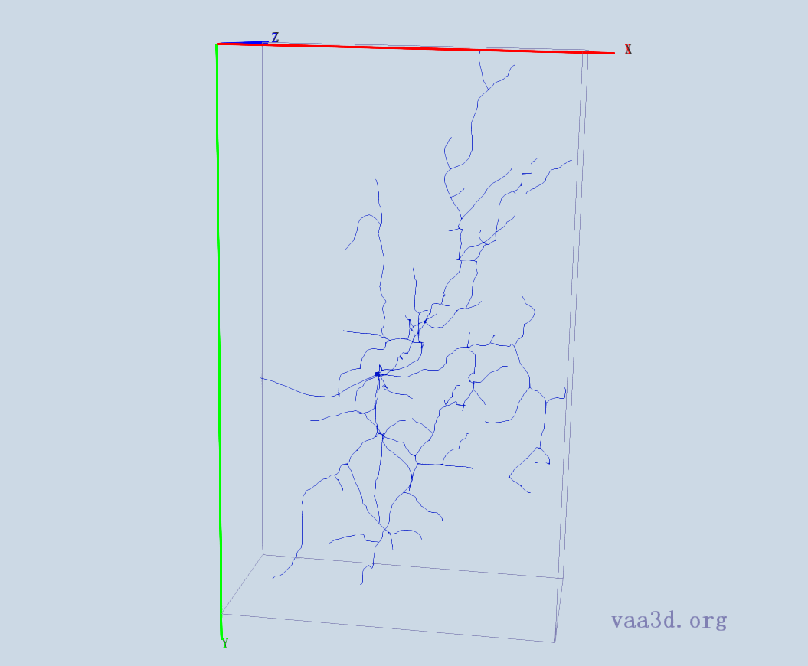
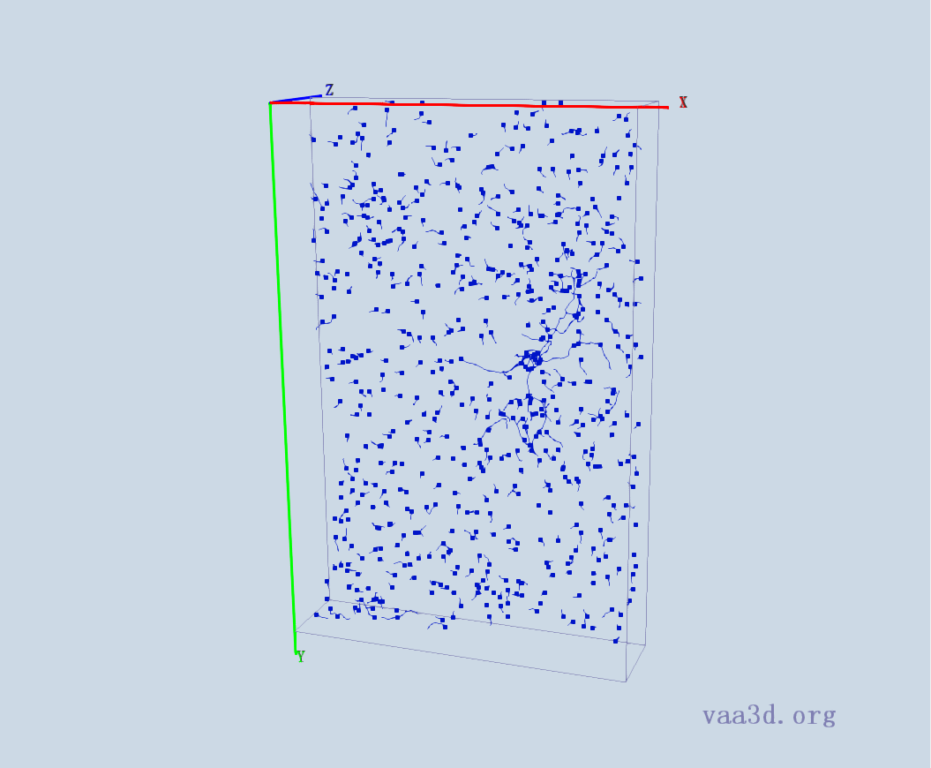
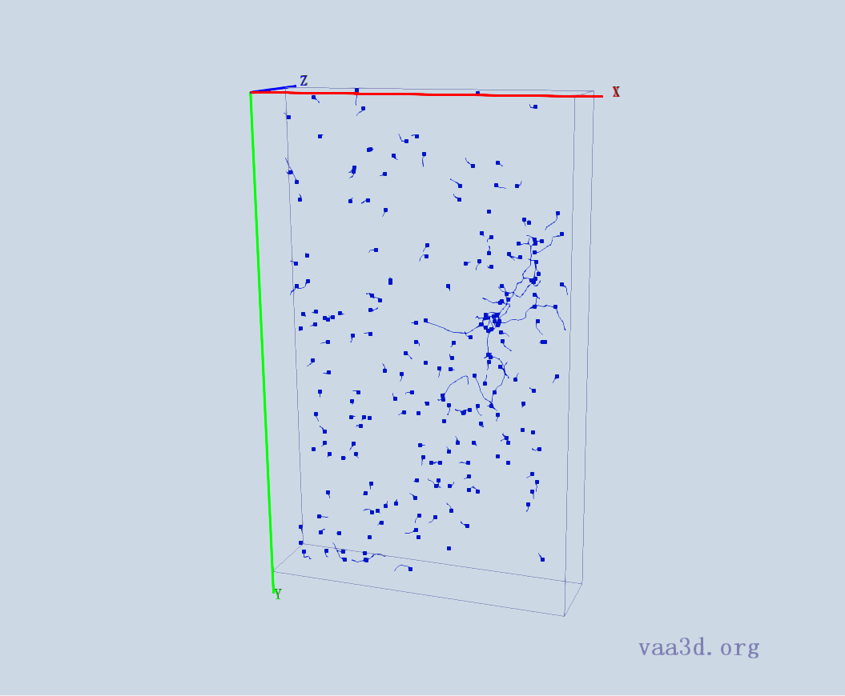
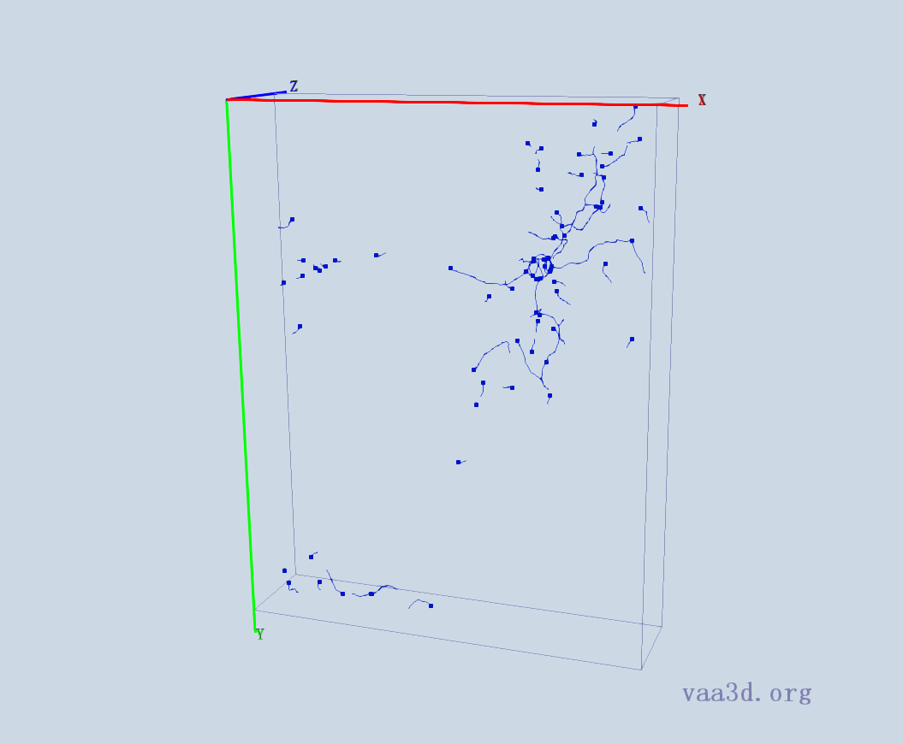
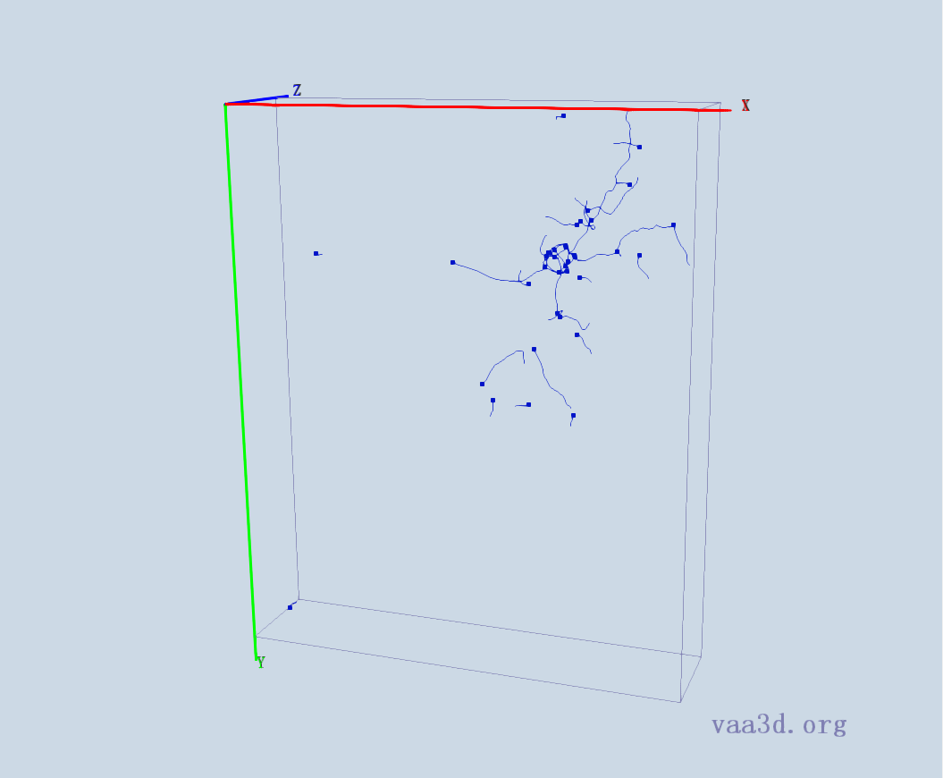

1_8_Ch2
GT
Thre=30 Thre=33 Thre= 34
Thre=35 Thre=40

Slide 3
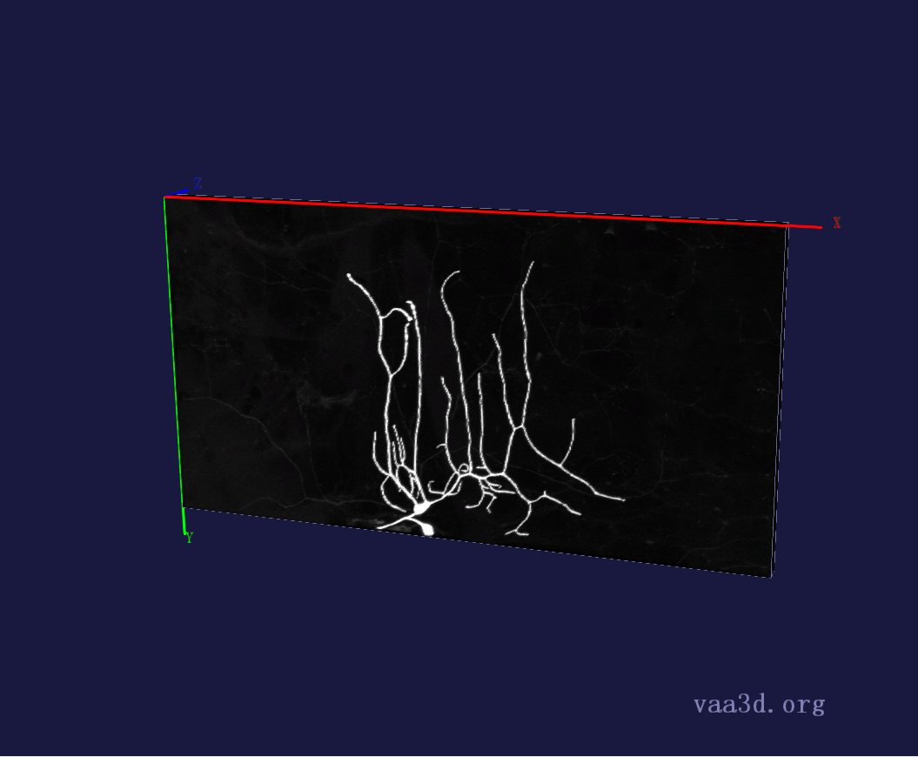
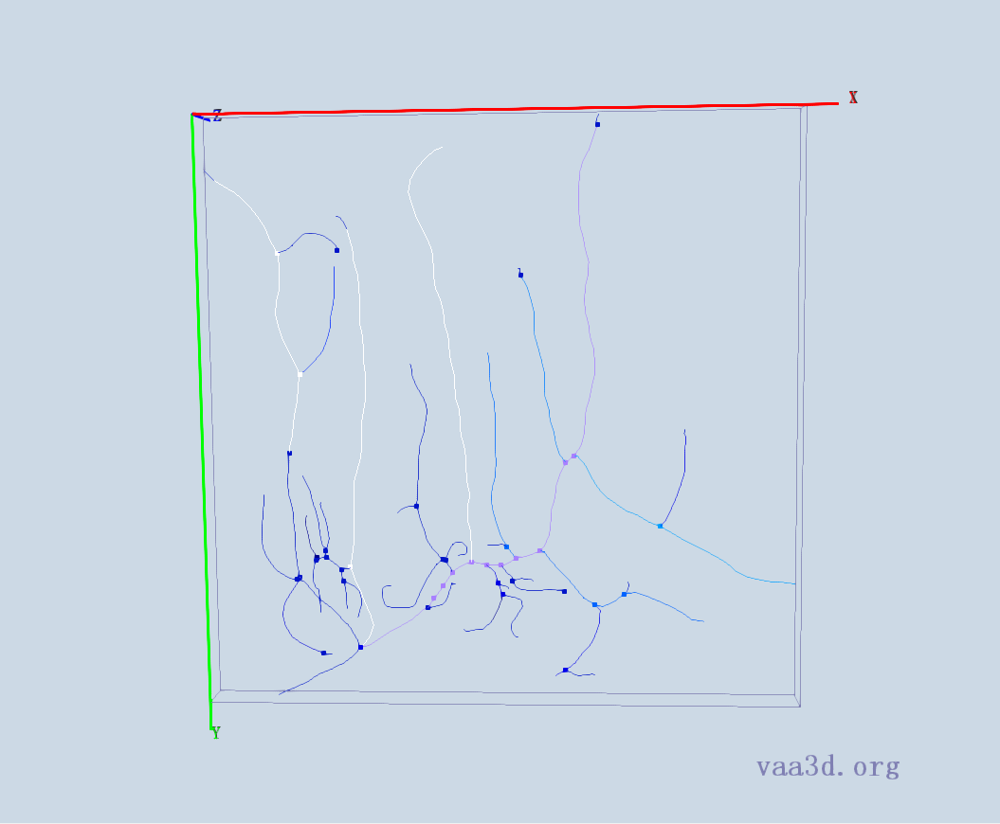
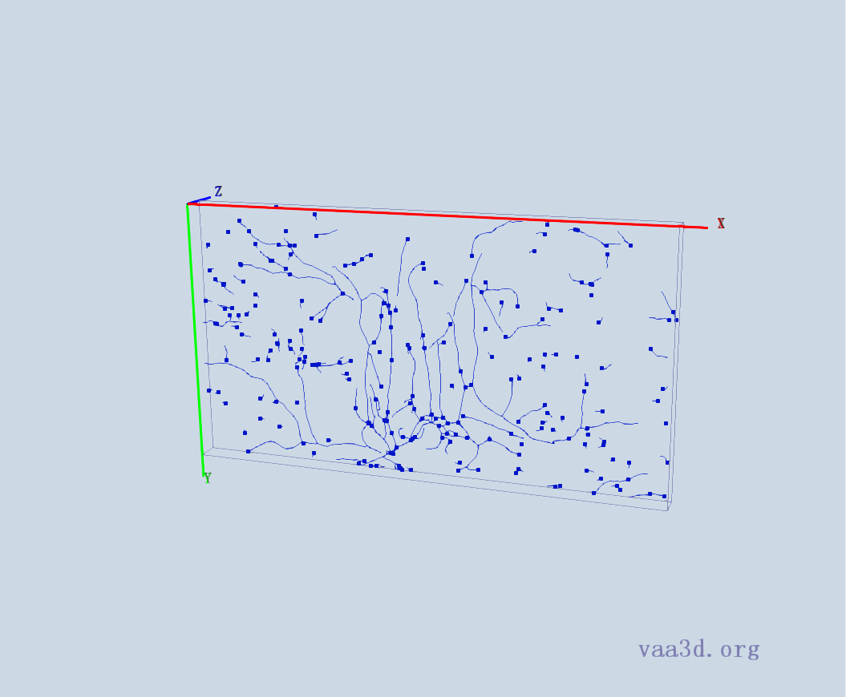
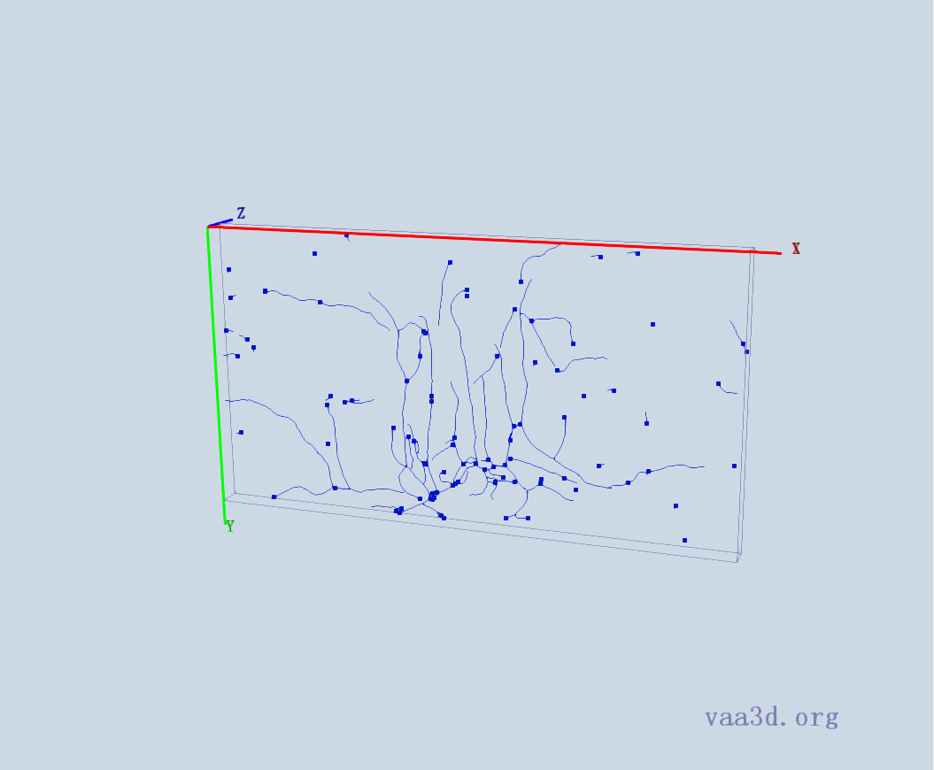
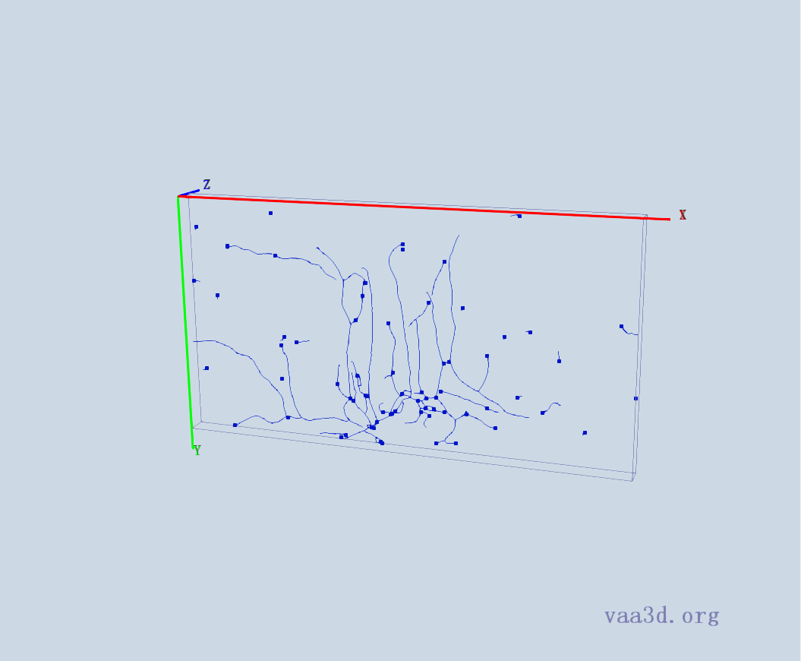
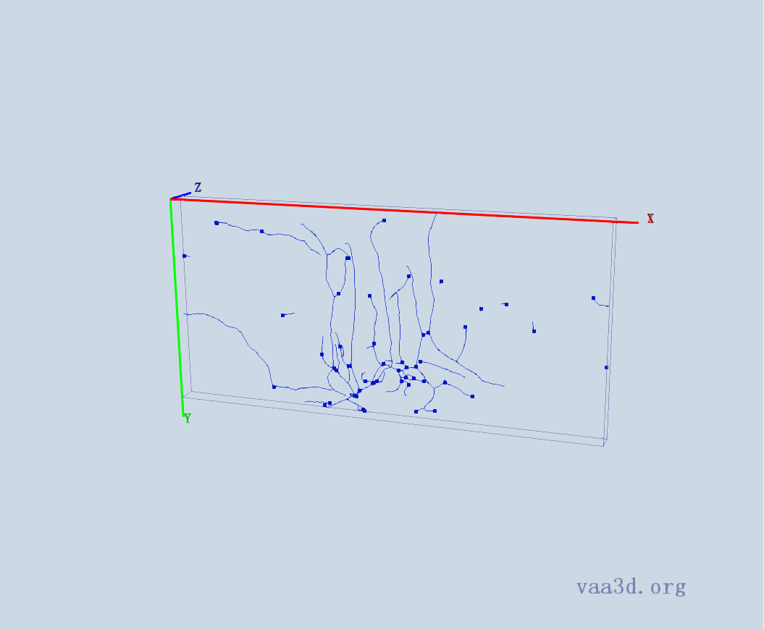
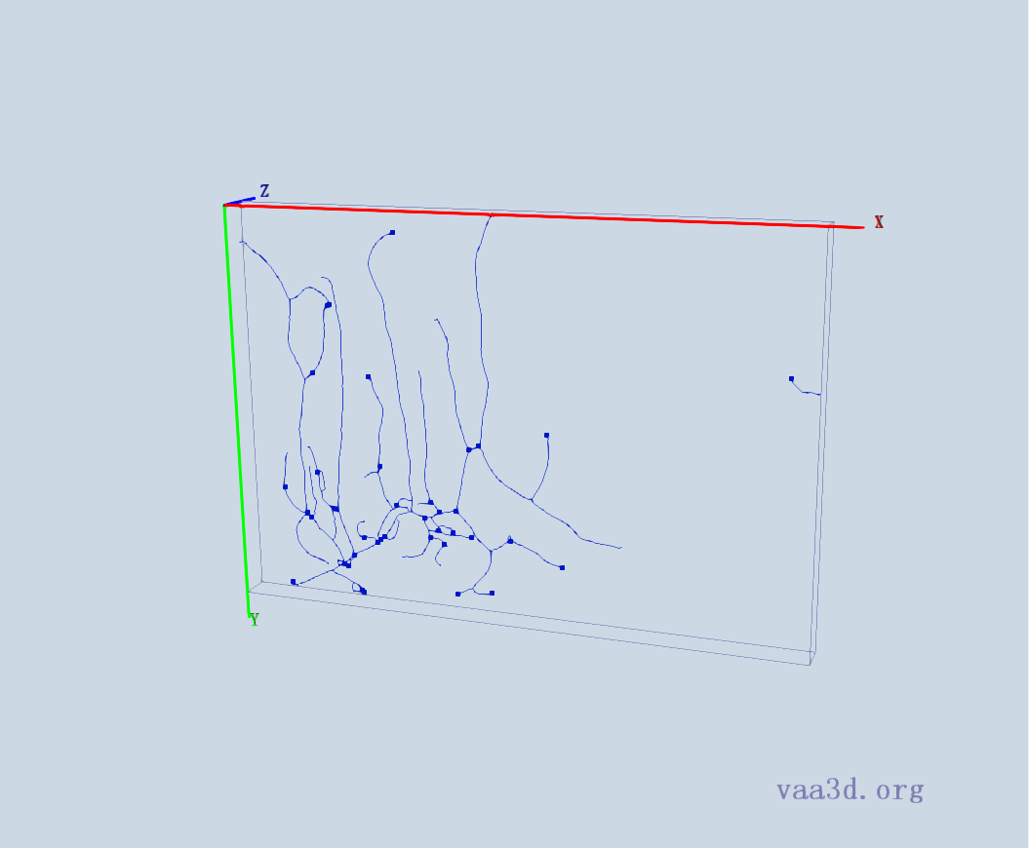
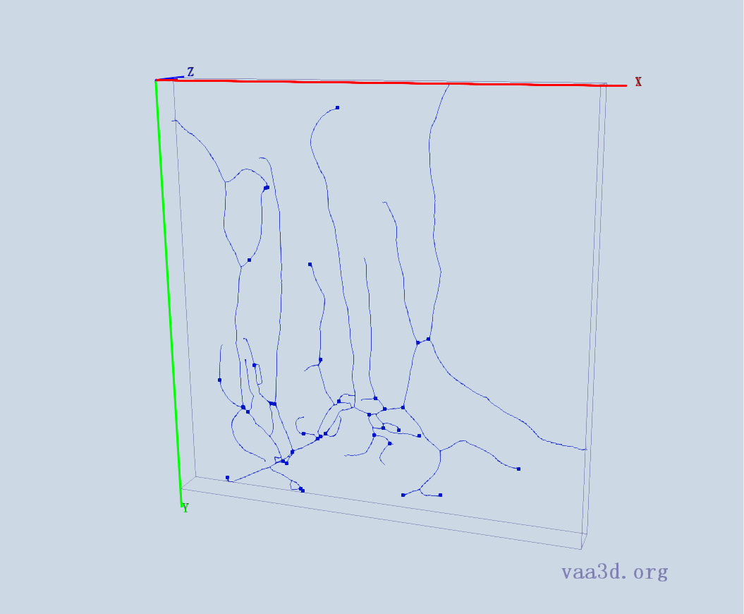
2_CL-I_Membrane-GFP_X_F-Actin-Red_ddaE
GT
Thre=15 Thre= 20 Thre= 21
Thre=22 Thre= 23 Thre= 25

Slide 4
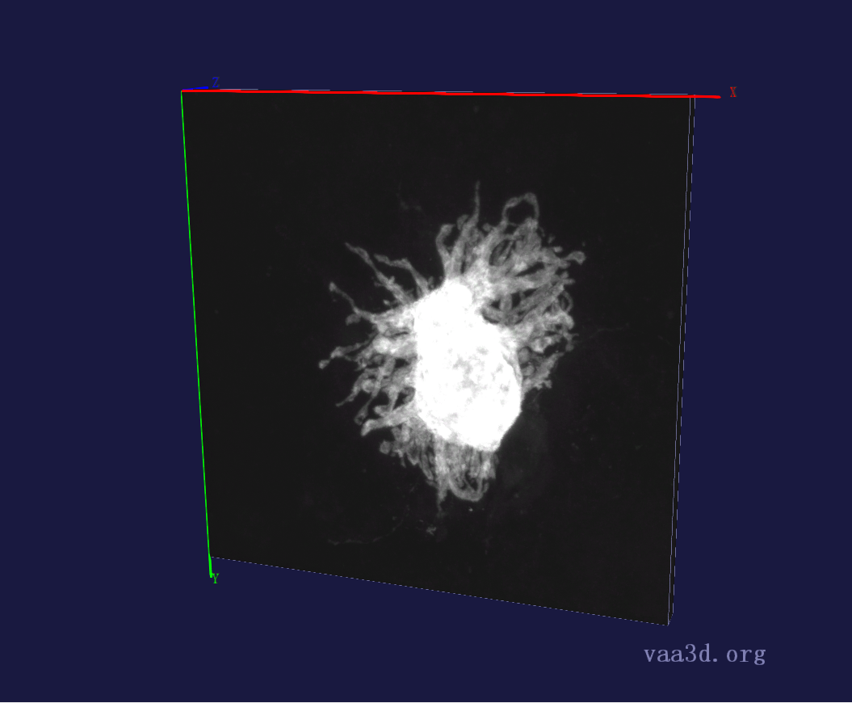
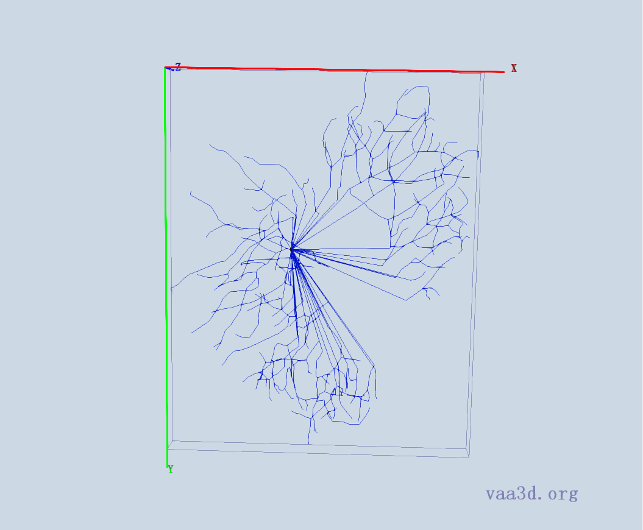
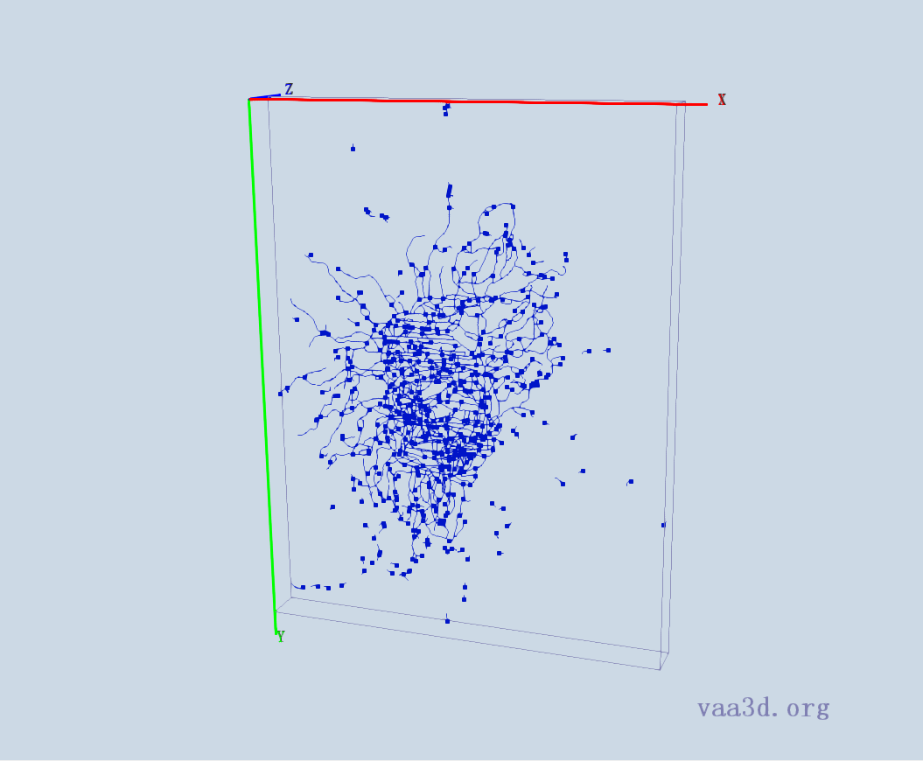
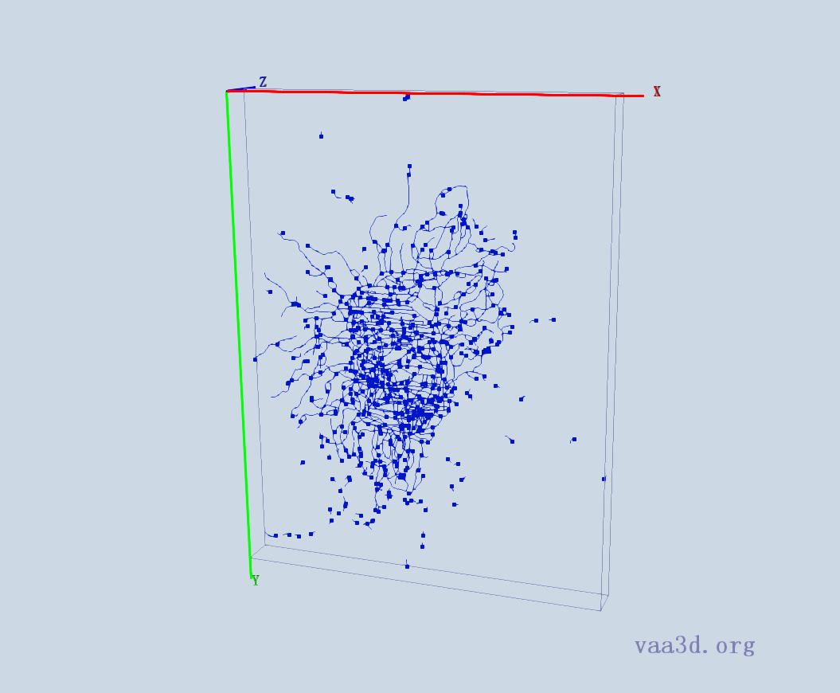
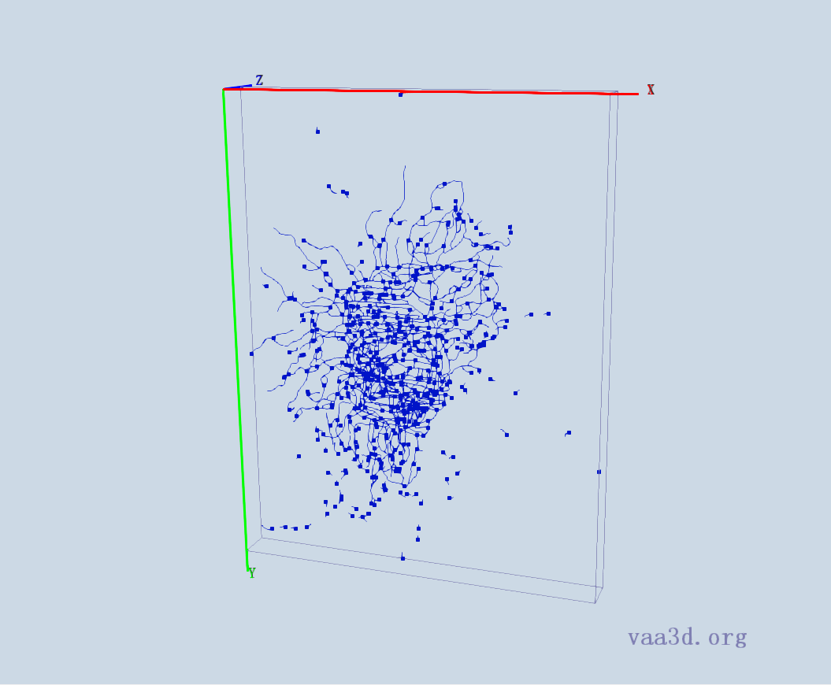
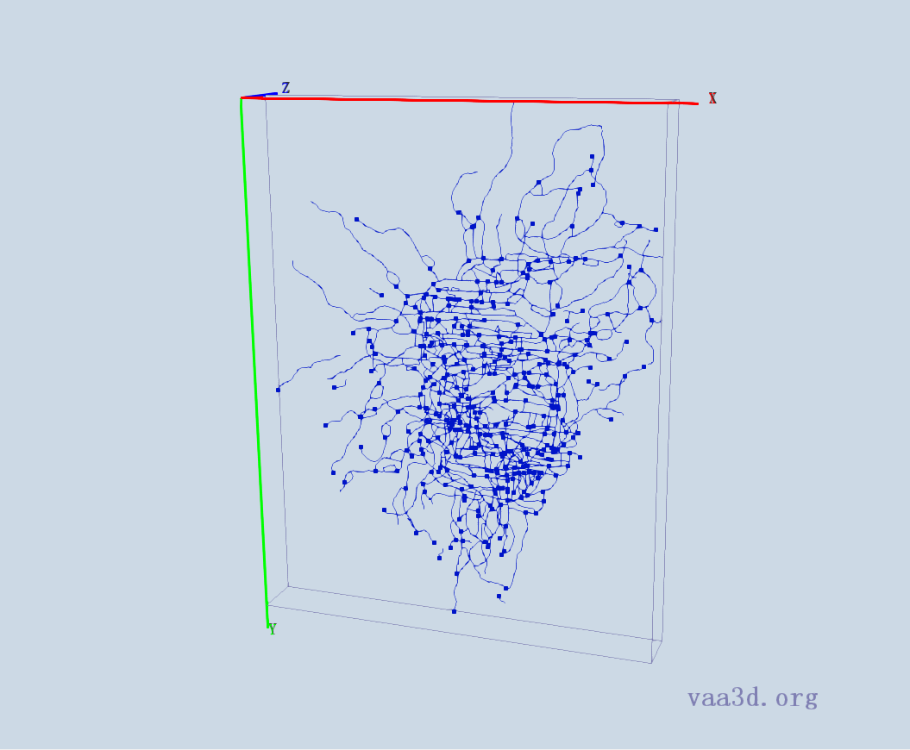
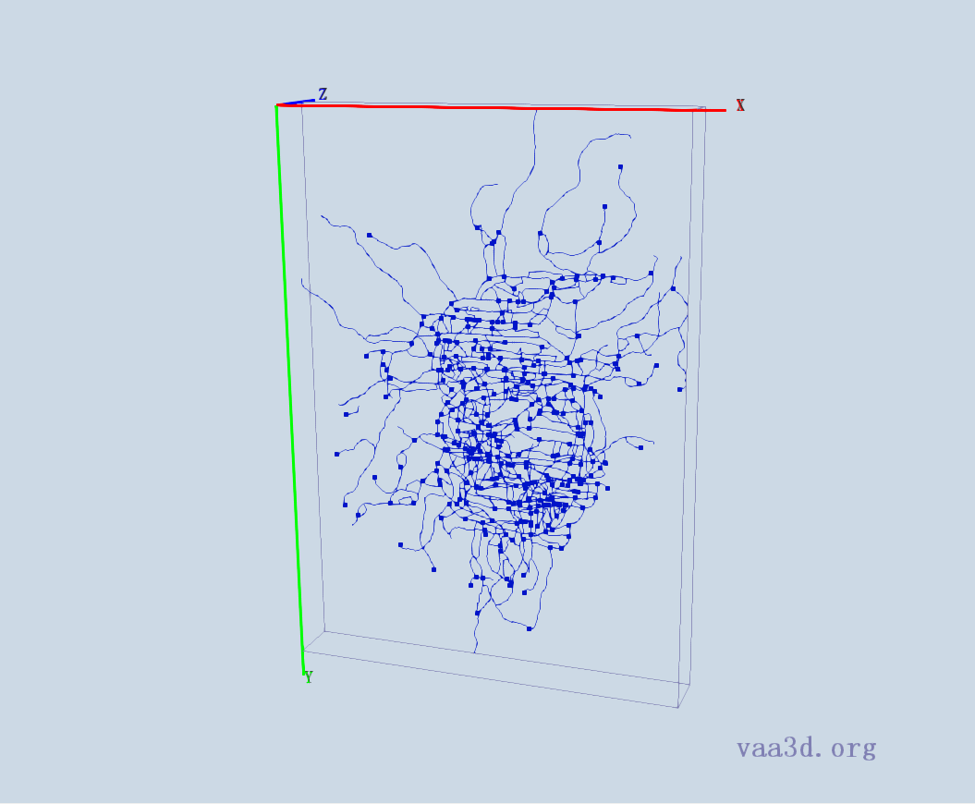
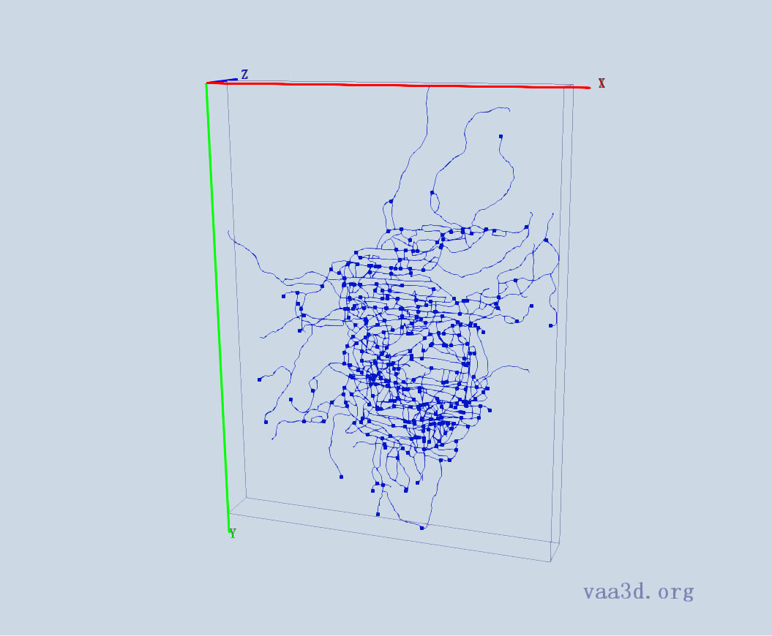
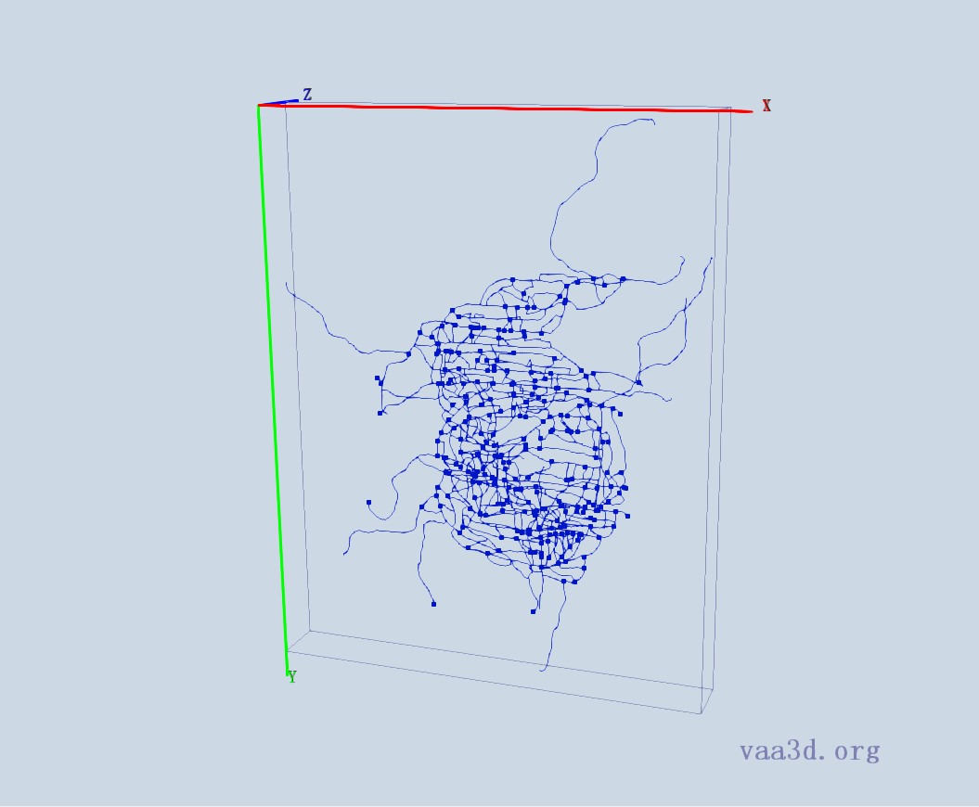
10-2909-s5-left-cell3_merge_c2
10-2909-s5-left-cell3_merge_c2
GT
Thre=1 Thre= 2 Thre= 3
Thre=4 Thre= 5 Thre= 6 Thre= 10

Slide 5
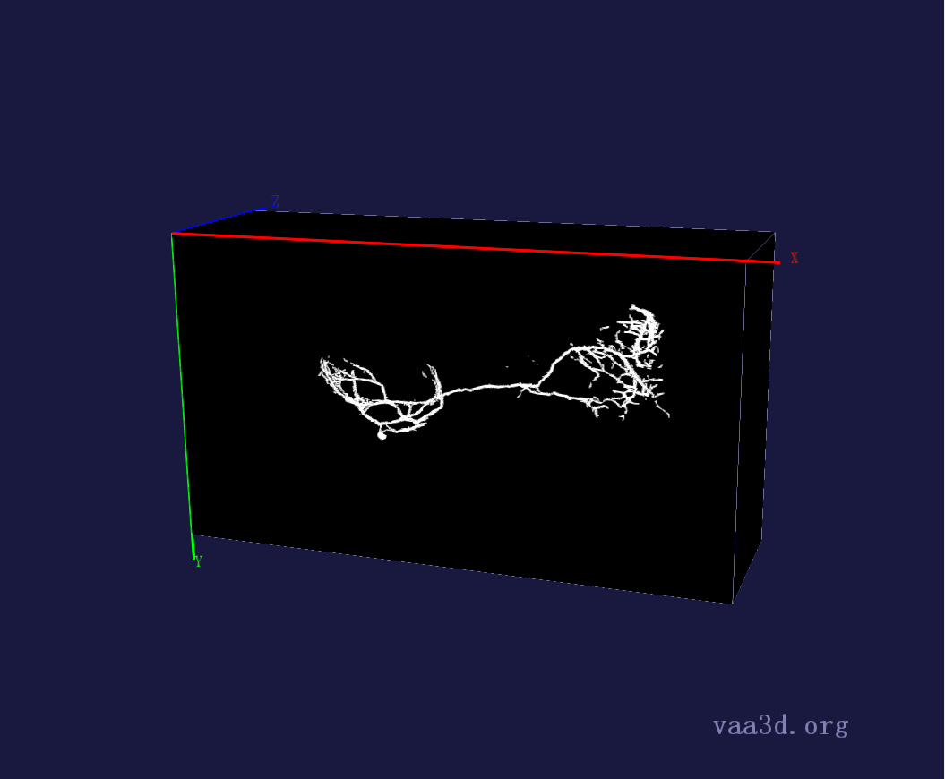
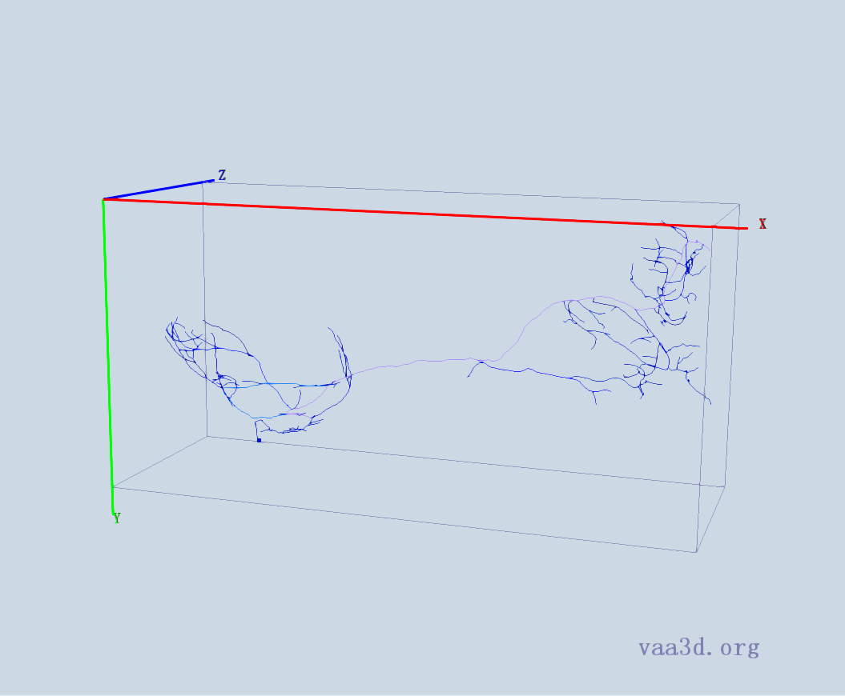
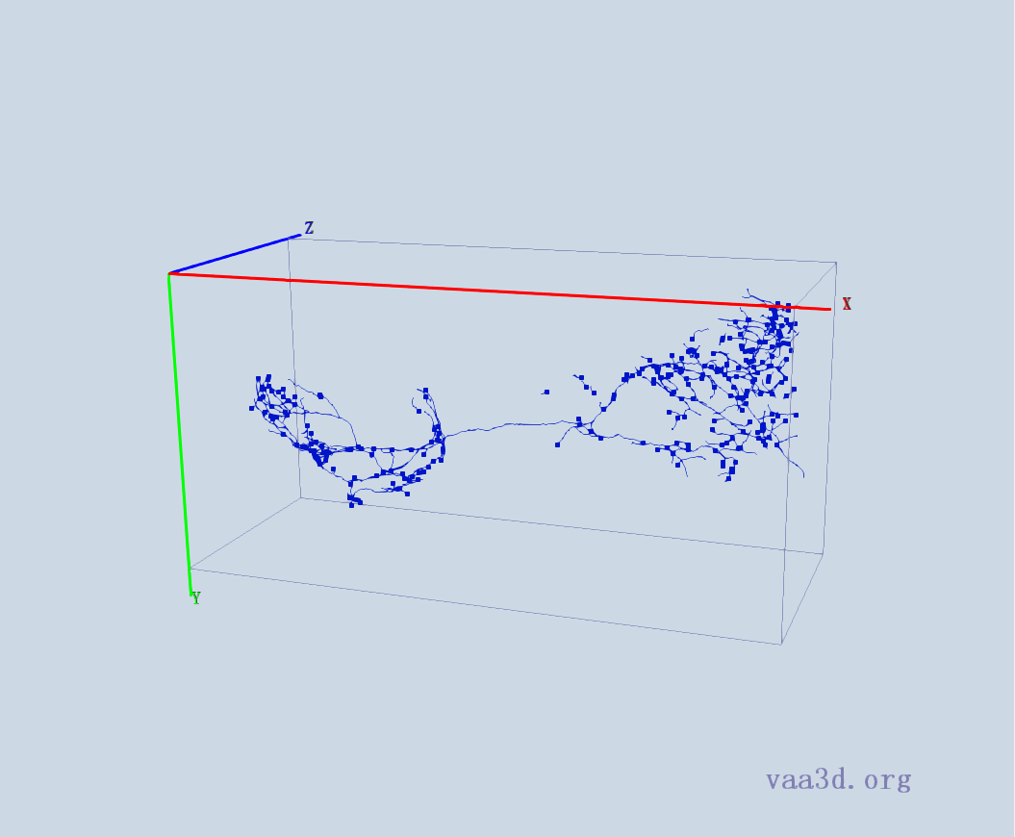
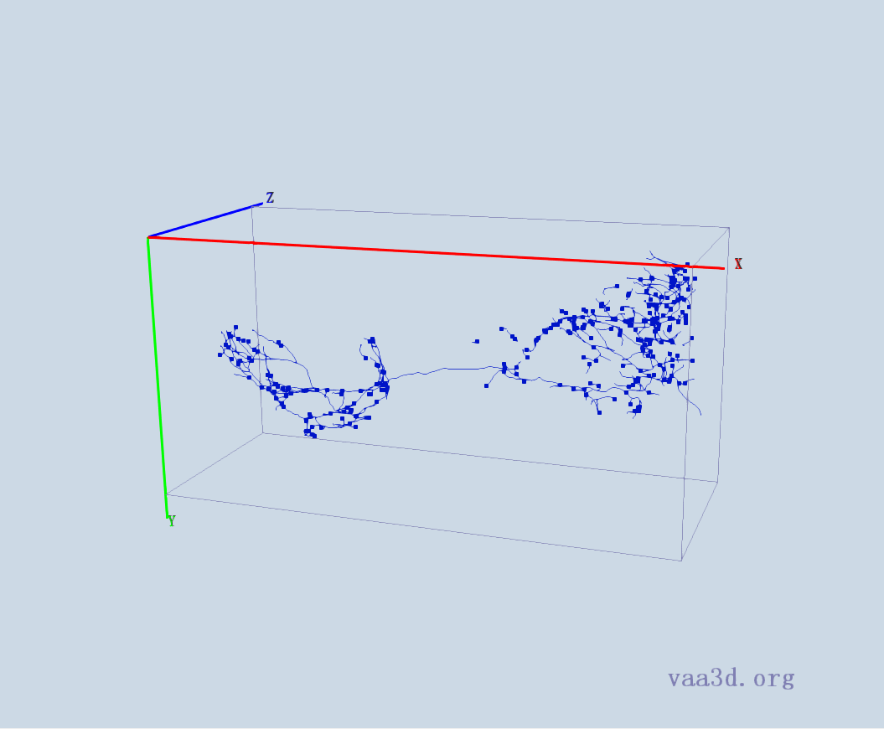

0664_seg
GT
Thre=5 Thre= 10 Thre=15
Thre=20 Thre=25 Thre=30 Thre=35

Slide 6
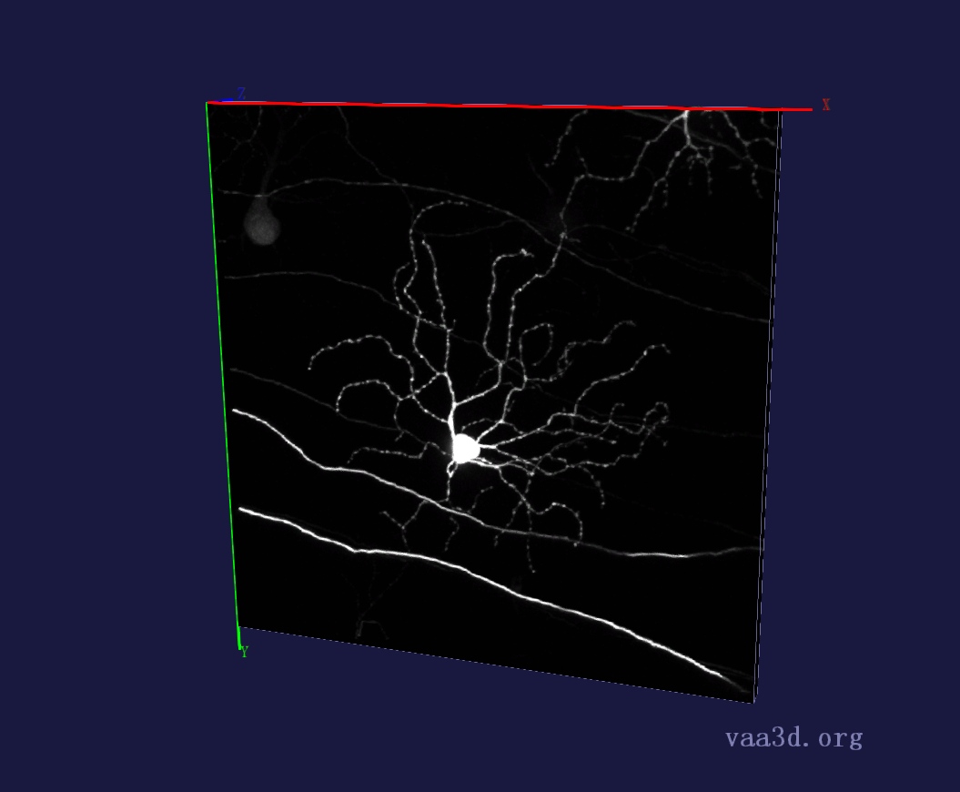
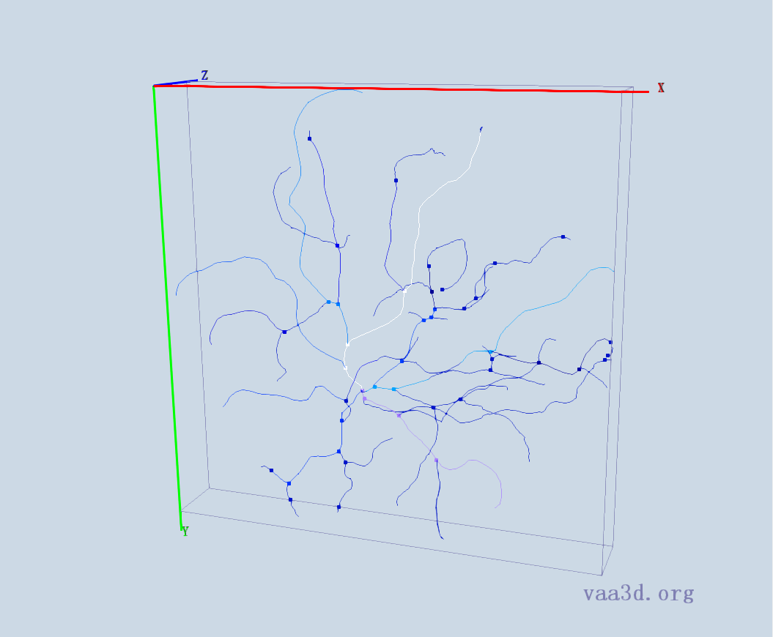
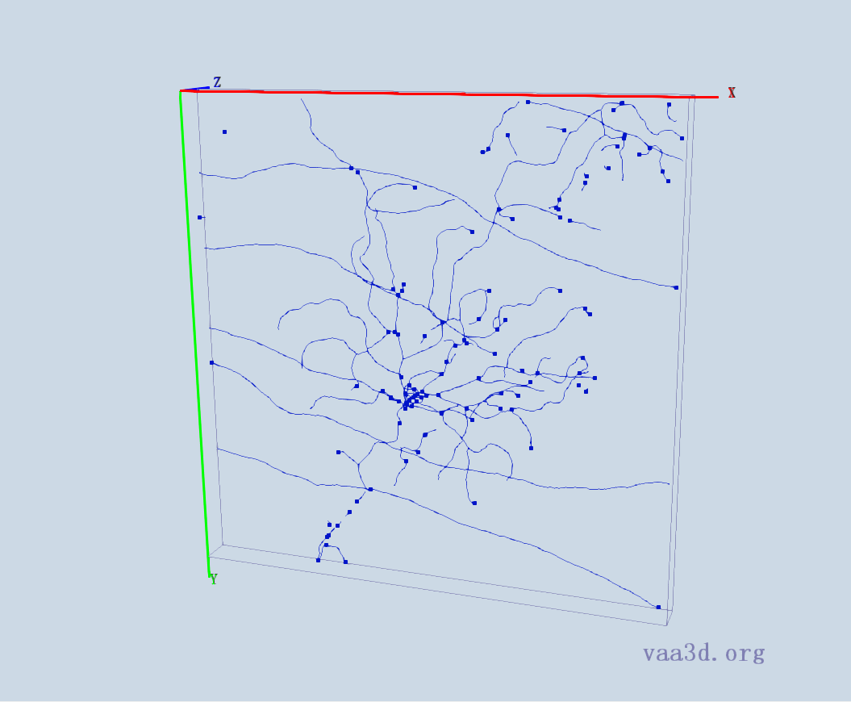
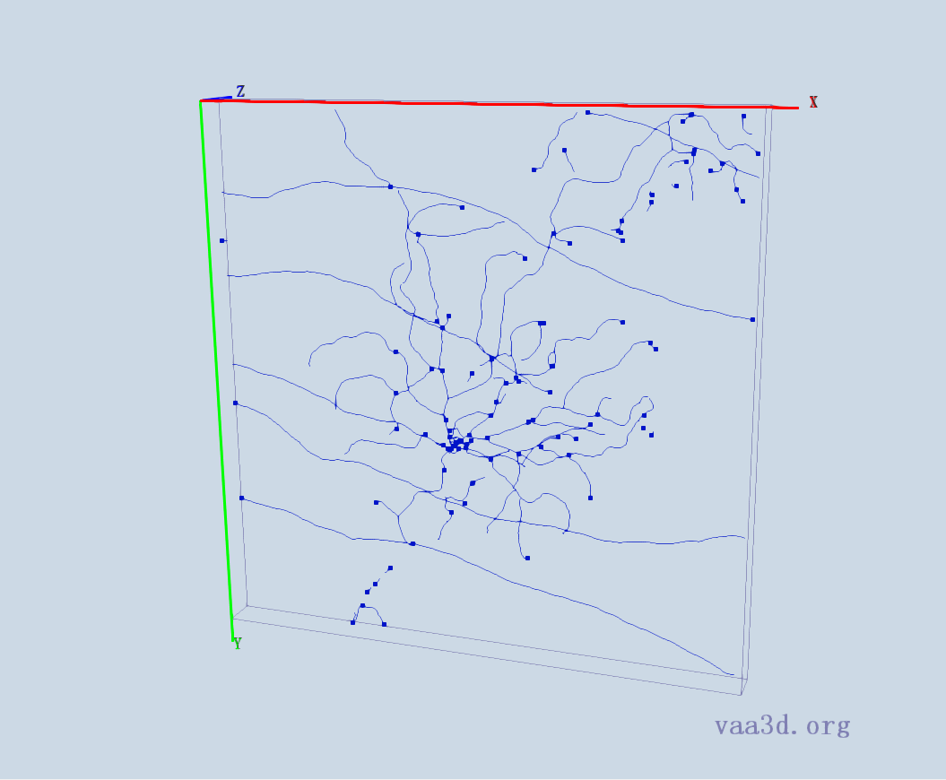
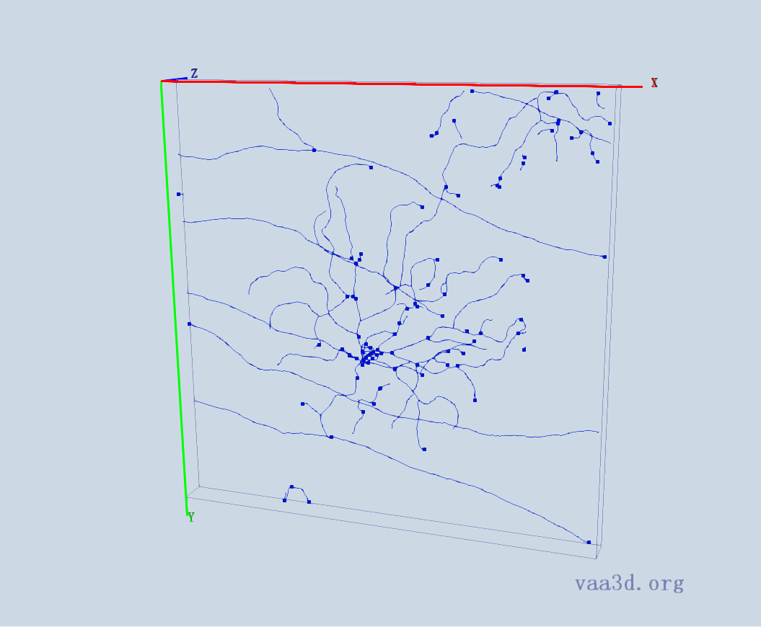
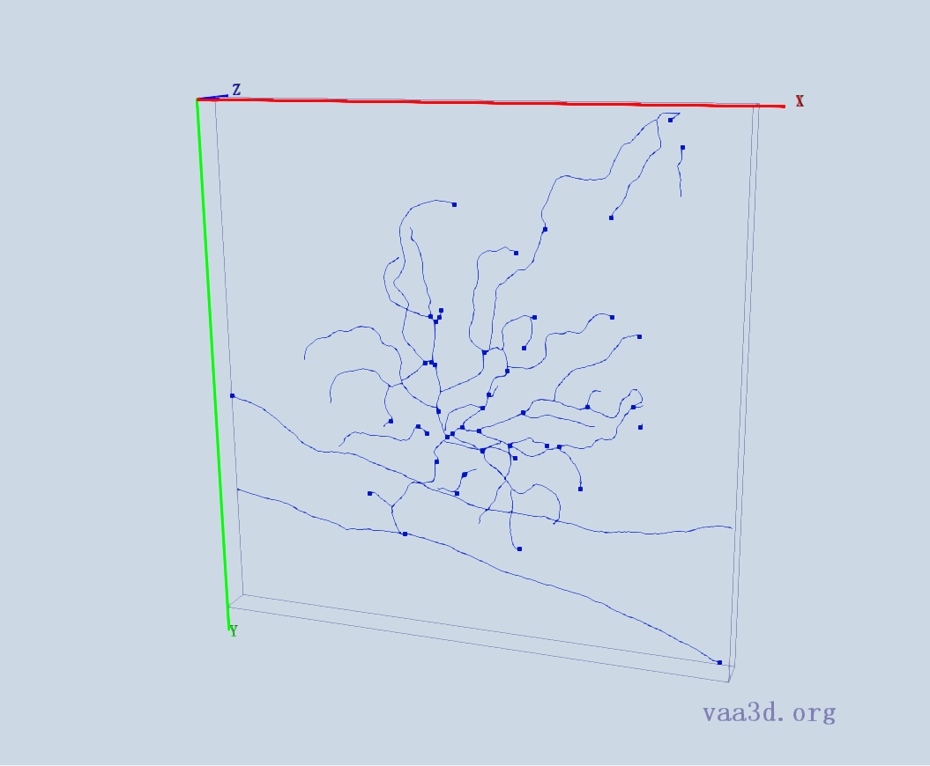
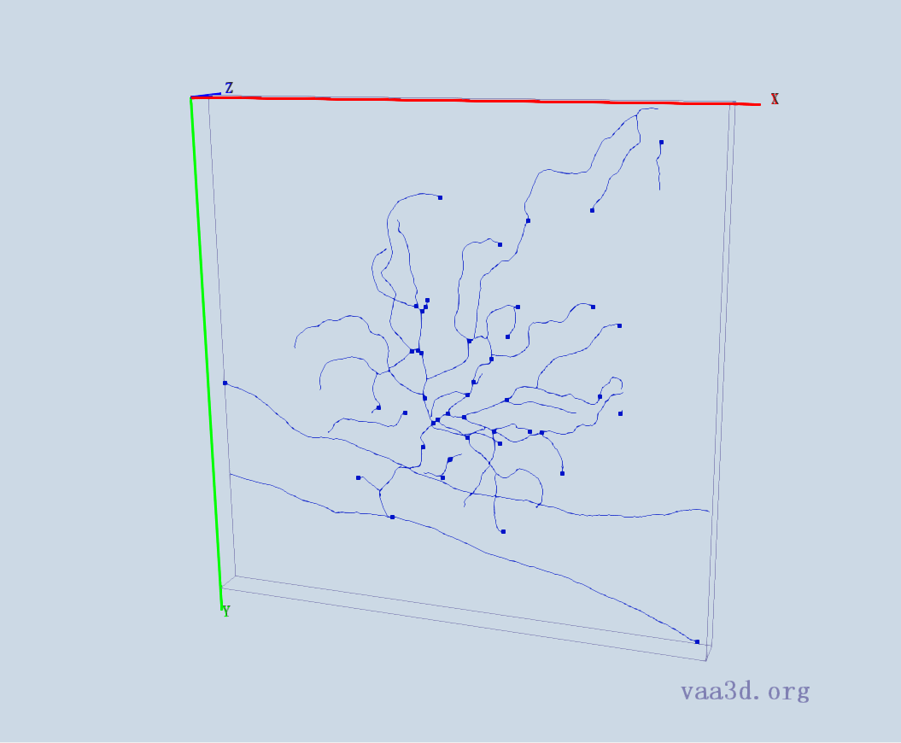
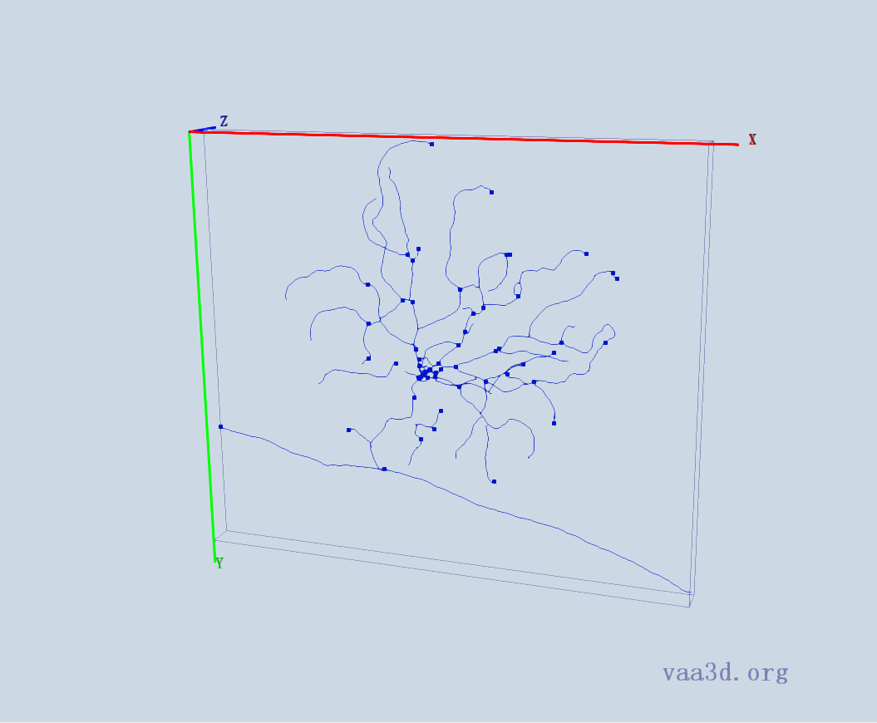
140918c8
GT
Thre=25 Thre= 30 Thre=35
Thre=65 Thre= 69 Thre=71 Thre=75

Slide 7
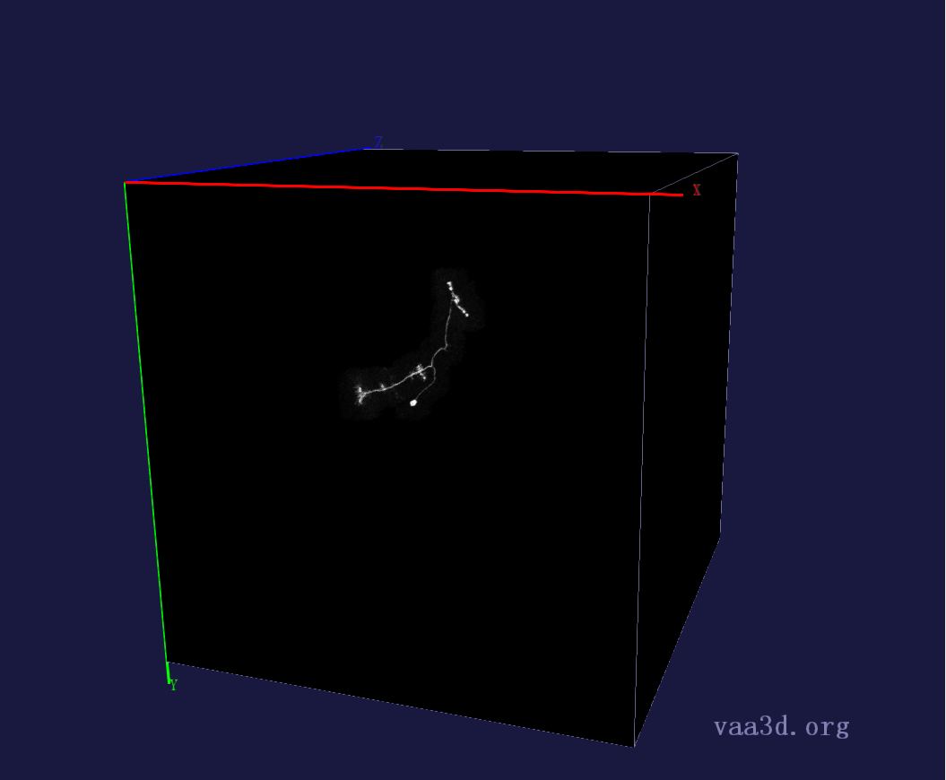
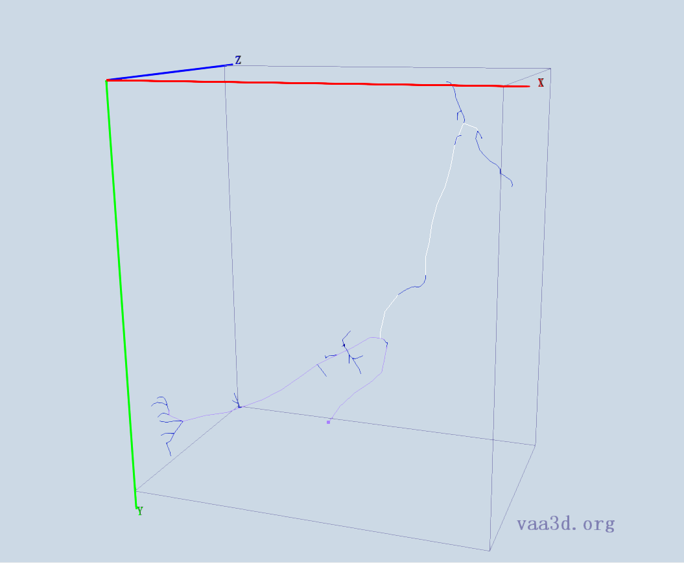
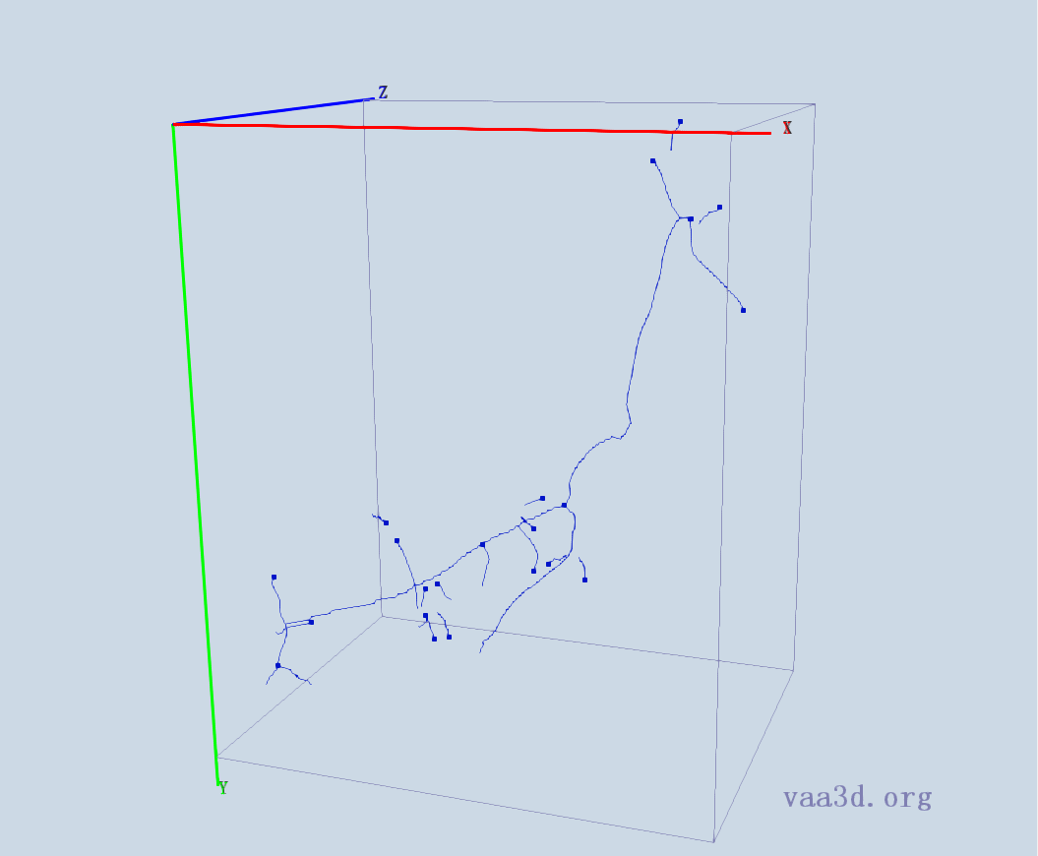

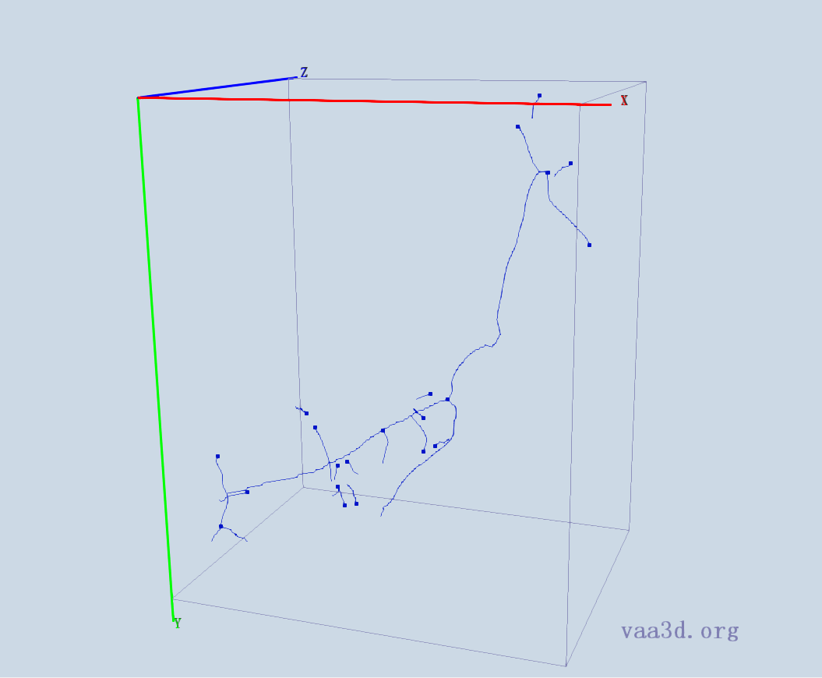
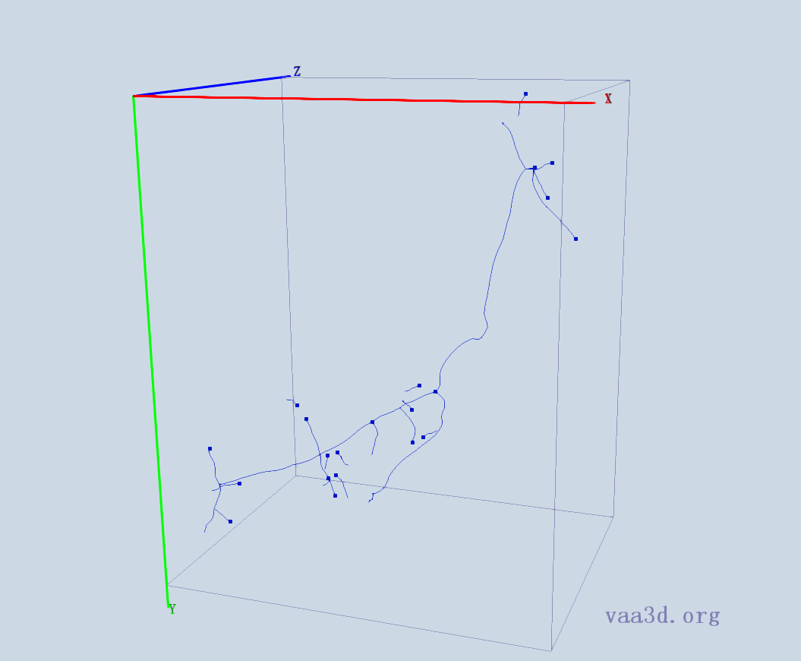
GMR_A3-
GT
Thre=1 Thre= 3 Thre=5
Thre=7 Thre=10

Slide 8
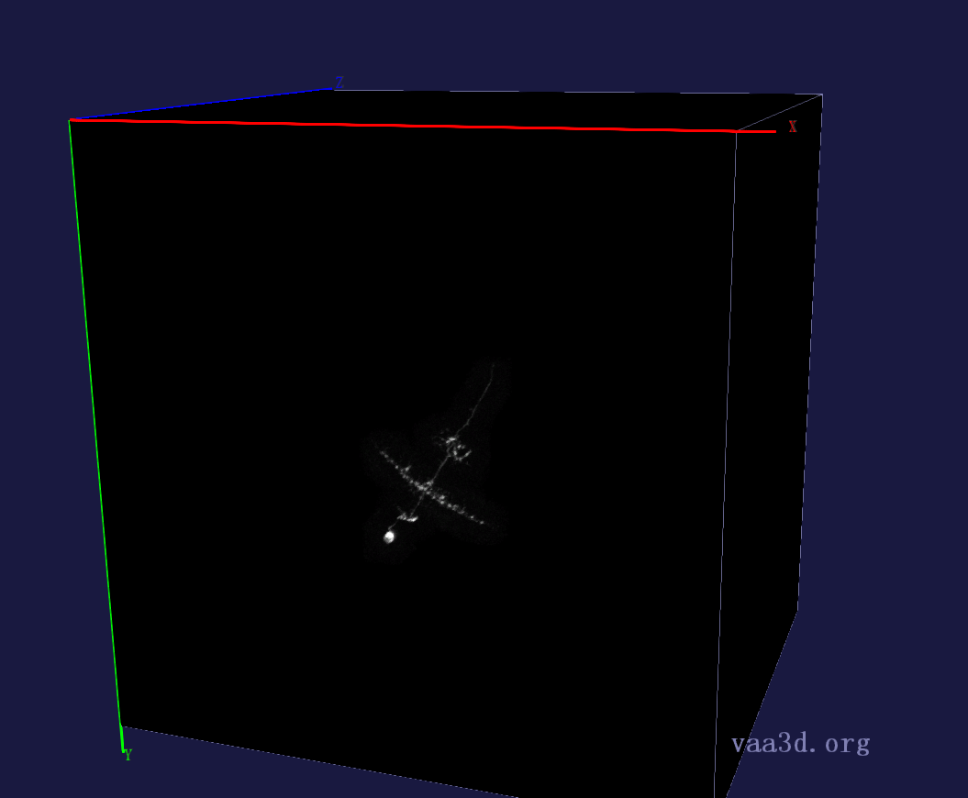
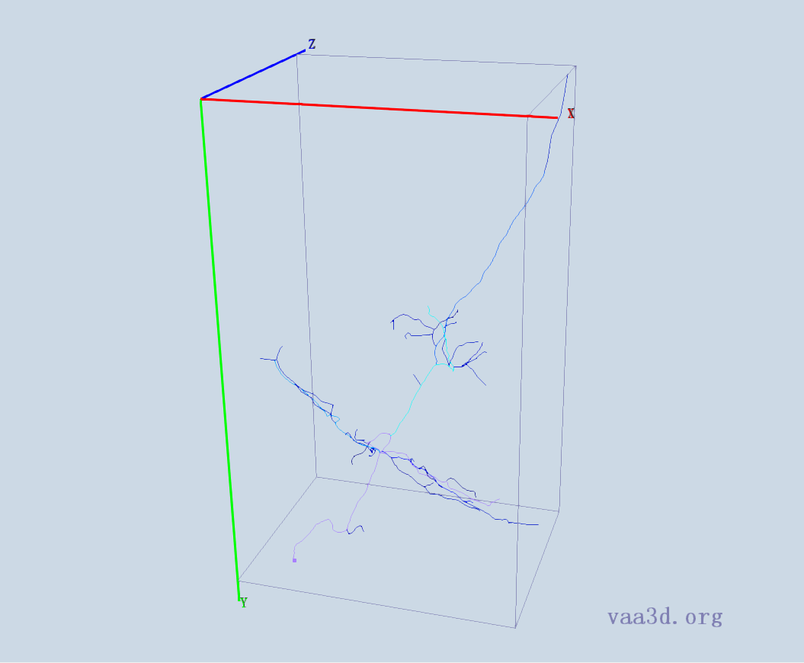
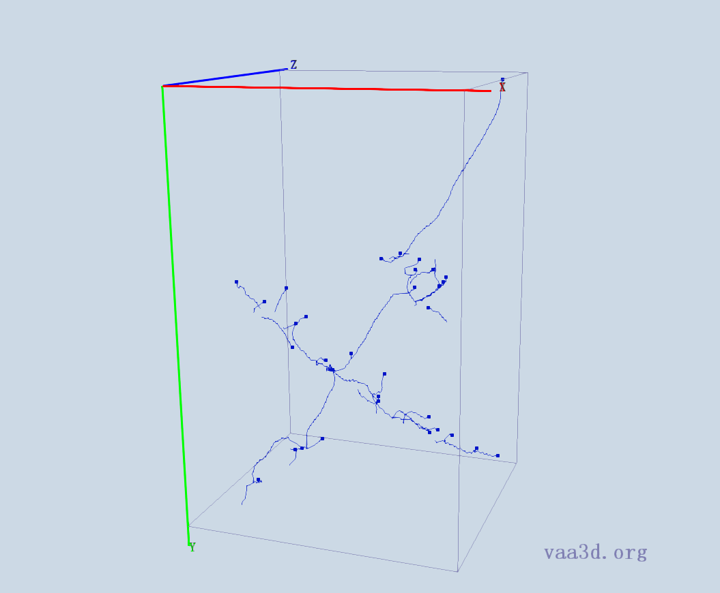
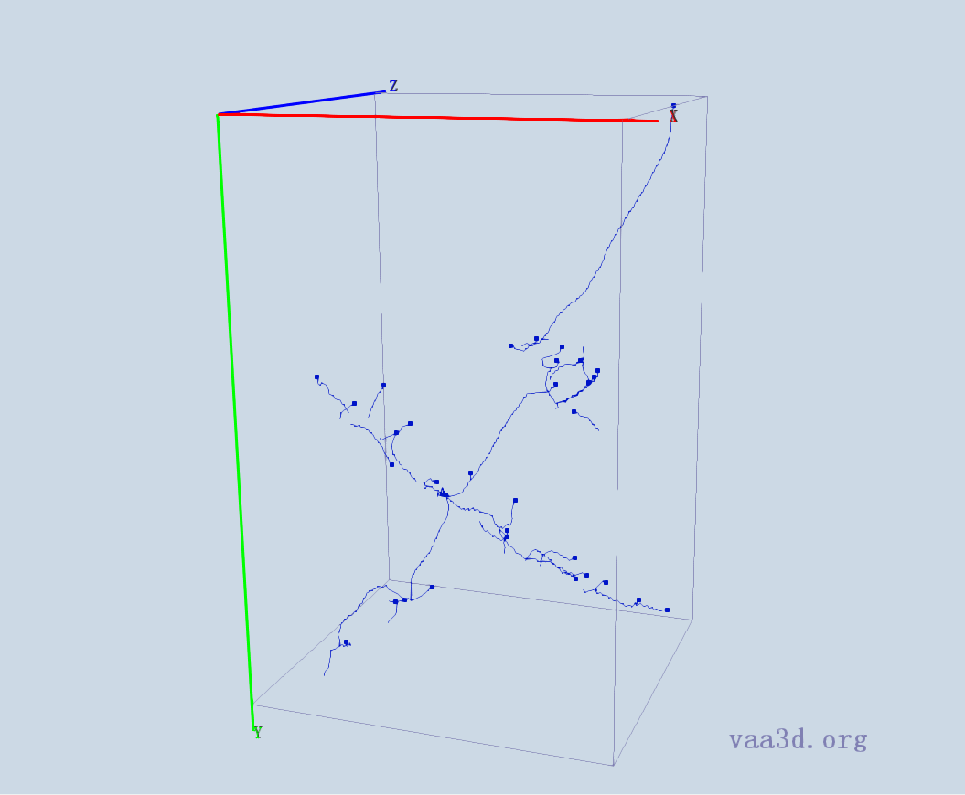


GMR_B2
GT
Thre=1 Thre= 3 Thre=5
Thre=10

Slide 9






GMR_D3
GT
Thre=1 Thre=2 Thre=3
Thre=4 Thre=5

Slide 10







GMR_C1
GT
Thre=1 Thre= 5 Thre=10
Thre=15 Thre=20

Slide 11





GMR_D2
GT
Thre=1 Thre= 3 Thre=5

Slide 12





GMR_E1
GT
Thre=1 Thre= 3 Thre=5

Slide 13




GMR_E2
GT
Thre=1 Thre= 3 Thre=5

Slide 14







GMR_E4
GT
Thre=1 Thre= 3 Thre=5
Thre=7 Thre=10

Slide 15





GMR_F3
GT
Thre=1 Thre= 3 Thre=5

Slide 16






Image-7
GT
Thre=40 Thre=50 Thre=60
Thre=70

Slide 17





Image-10
GT
Thre=40 Thre=50 Thre=60

